Slide 1
Reach of the Pandemic
Analysis on Corona Virus
R.H.S.BHARADWAJA

Slide 2
PROBLEM STATEMENT
2020 has been a nightmare to the entire due to an epidemic, Corona. There are hundreds of causalities daily due this virus and the number of positive cases are increasing as we speak.
The main agenda is to find which are all countries that are handling this epidemic efficiently and visualizing all the details of each country on a map for better understanding of what is happening around the world regarding the virus.
There will an analysis on country level for this project.

Slide 3
DATA ACQUISITION
We actually in search of 2 sources. One, information of each country’s statistics on corona and locations details of each country which is helpful for visualization purpose.
Information regarding Confirmed cases, Recovered etc., are available in Wikipedia for us to use.
Location of countries are available as a csv file provided by google under the name “Countries.csv” which contains latitudes and longitudes every country.

Slide 4
DATA SCIENCE METHODOLOGY
It was extracted using BeautifulSoup and created a Data frame for analysis purpose.
Data Cleaning was done to remove all Nan (Not a number) and characters like – or _ are replaced with 0.
Joining of cleaned data frame is done with countries data frame that contained location details.
Addition new columns like “Recovery Rate” , “Pending percentage”, “Live Cases” is done for better understanding purpose.
Recovery Rate = (Recovered Count *100) / (Recovered count + Death count).
Pending percentage = (Live cases * 100) / Confirmed cases.
Used K means clustering algorithm to cluster countries into 4.

Slide 5
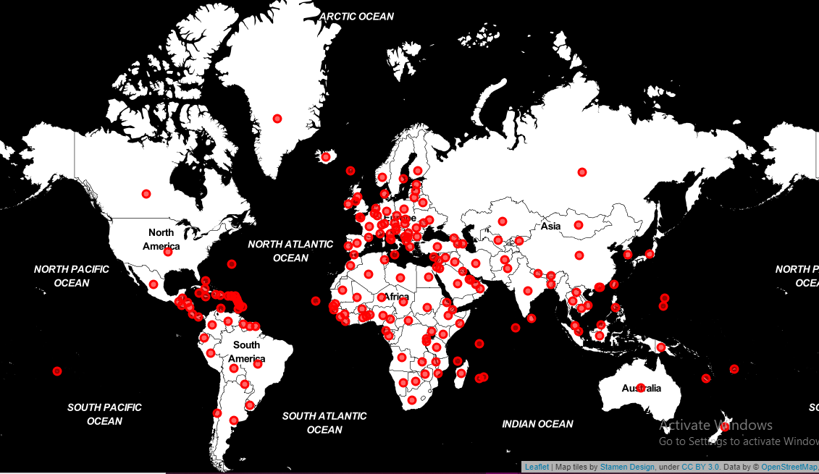
Before Clustering

Slide 6
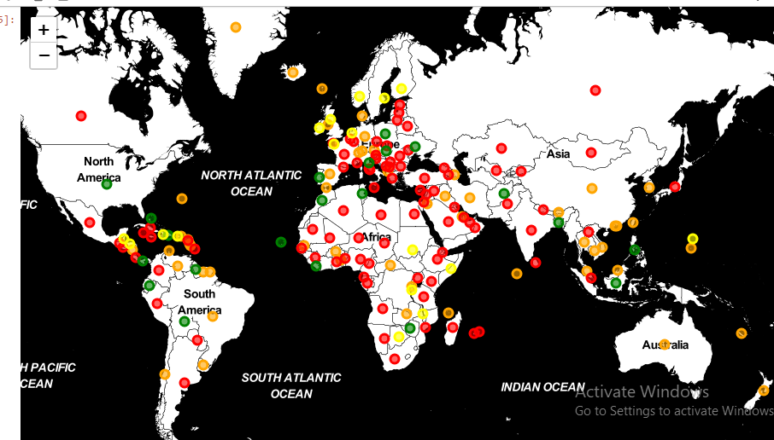
After Clustering

Slide 7
CONCLUSION
As we can see the countries with less pending percentage and high Recovery Rate are clustered into one zone and they are very few countries this cluster, namely Greenland, South Korea etc.,
Observing Map over a period of time (Like a daily or weekly report) can help us with more insights like, which countries are moving between clusters and according we will get to know whether severity is increased or decreased.
Many more observations can be made if we continue his project with each state’s data.

